Slide 1
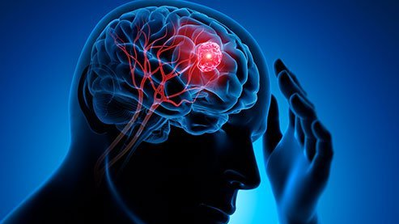
Brain tumor segmentation with
U-Net and FC-DenseNets
Junchol Park
Springboard mentors:
Dipanjan Sarkar
Image credit: www.medicinenet.com

Slide 2
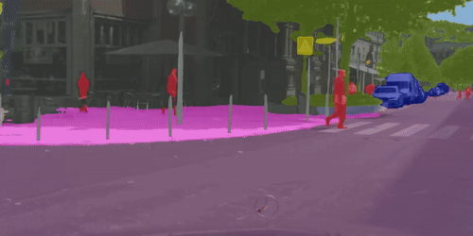
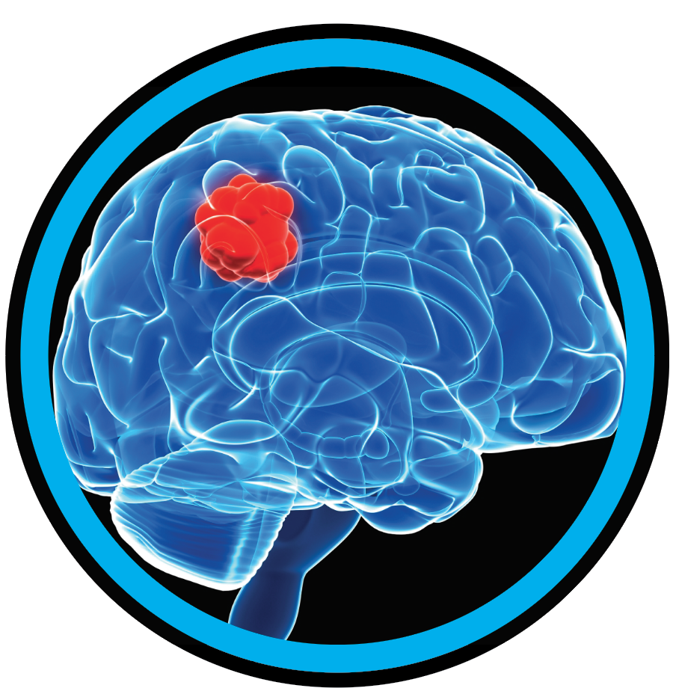
Intro.
What are in this image, and where in the image are they located?
Semantic image segmentation predicts class labels for each pixel in the image.
A key application in image processing and computer vision, which has been widely used in numerous areas such as intelligent transportation.
An example segmentation map
Image credit: George Seif
Brain Tumor Segmentation
With U-NET, FC-DenseNets

Slide 3
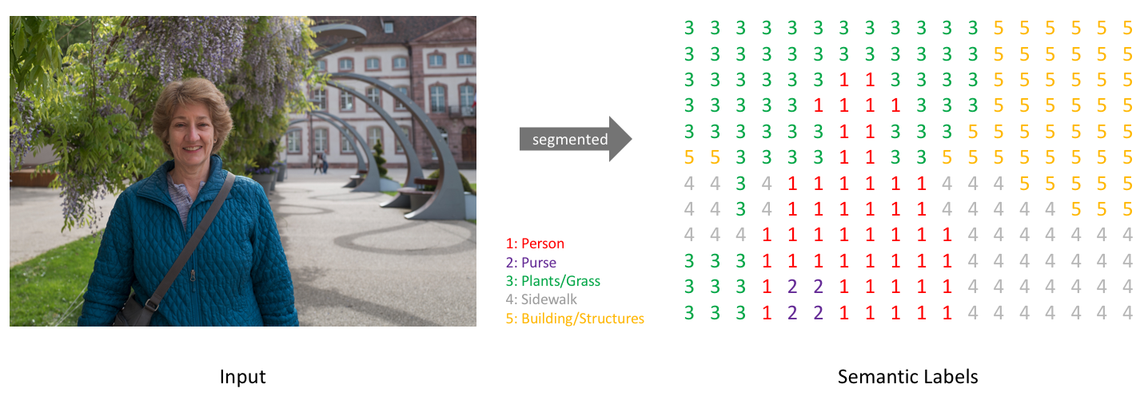
Intro.
It takes RGB or grayscale images and generates a segmentation map where each pixel contains a class label as an integer
In medicine, image segmentation is widely used for diagnostics.
One active area of research is brain tumor segmentation on MRI scans.
In this project, we tackle tumor segmentation using two state-of-the-art convolutional neural networks – U-Net, FC-DenseNets.
An example segmentation map
Image credit: www.jeremyjordan.me/semantic-segmentation
Brain Tumor Segmentation
With U-NET, FC-DenseNets

Slide 4
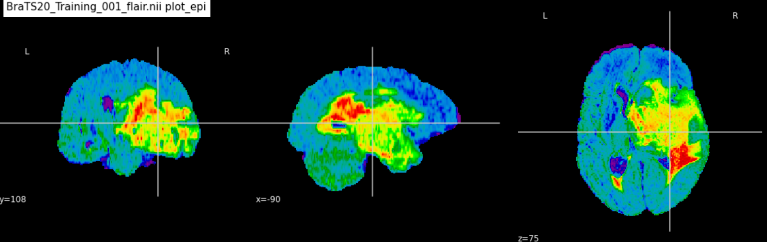

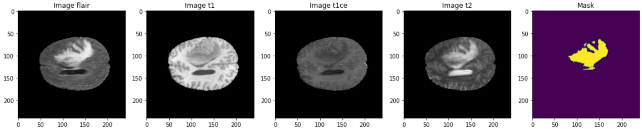
Dataset
The MRI data are collected/preprocessed by the BraTS community for 2020 BraTS challenge.
The dataset consists of 369 multimodal MRI scans of glioblastoma and lower grade glioma with accompanying ground truth labels by expert neuroradiologists.
For model training, we used images of two modalities: Flair, T1ce.
The dimension of each volume/modality is 240 (height) x 240 (width) x 155 (slices).
Brain Tumor Segmentation
With U-NET, FC-DenseNets

Slide 5
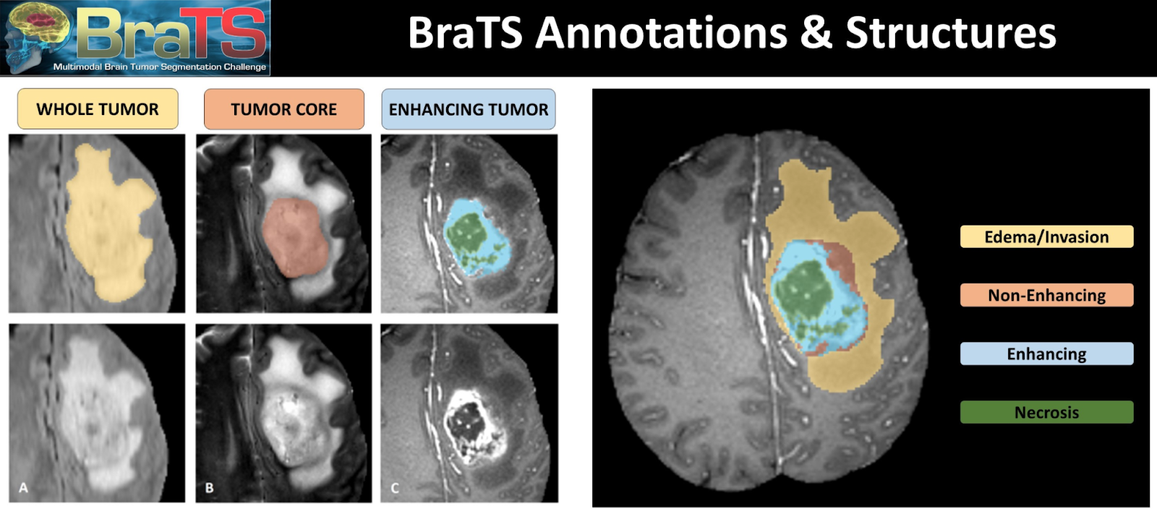
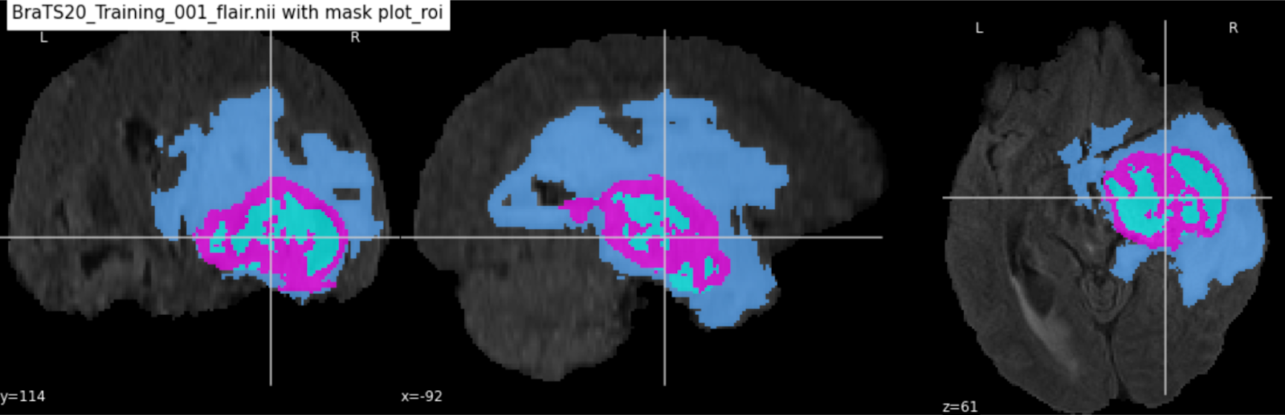
Dataset (target)
Ground truth annotations label each pixel into four classes.
NOT tumor (0)
NECROTIC/CORE (1)
EDEMA (2)
ENHANCING (3)
Brain Tumor Segmentation
With U-NET, FC-DenseNets

Slide 6

U-Net model: Architecture
Image credit: https://arxiv.org/abs/1505.04597
The U-Net architecture is composed of downsampling, upsampling paths and skip connections bridging the two.
Features in the images and the context information are learned through convolution and pooling in the downsampling path.
In the upsampling path, the learned features and context are propagated through convolution layers, while higher resolutions are recovered through skip connections and upsampling.

Slide 7
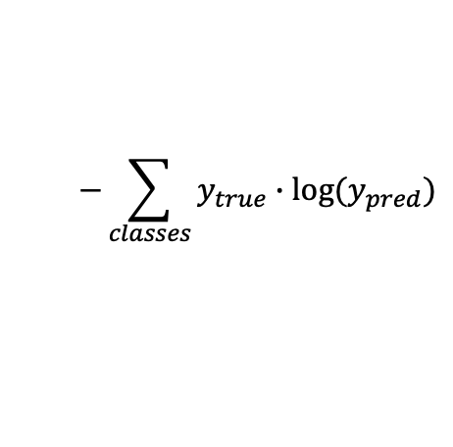
U-Net model details
$$−\sum_{classes}{y_{true}∙log⁡(y_{pred})}$$
Loss function: Pixel-wise cross entropy,
Optimizer: Adam
Learning rate (0.0001) was set to be reduced on plateau by a factor of 0.2.
During training model performance was evaluated on training and validation sets using accuracy, dice coefficient, and IoU as metrics.

Slide 8
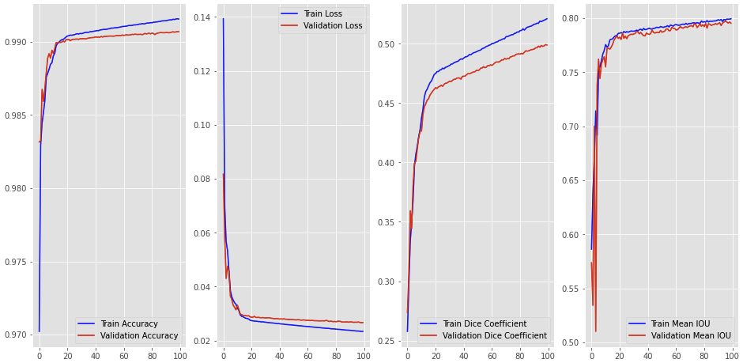
U-Net model: Training log
Convergence of loss function over training and validation data.
Also, the evaluation metrics improved over the course of training epochs.

Slide 9
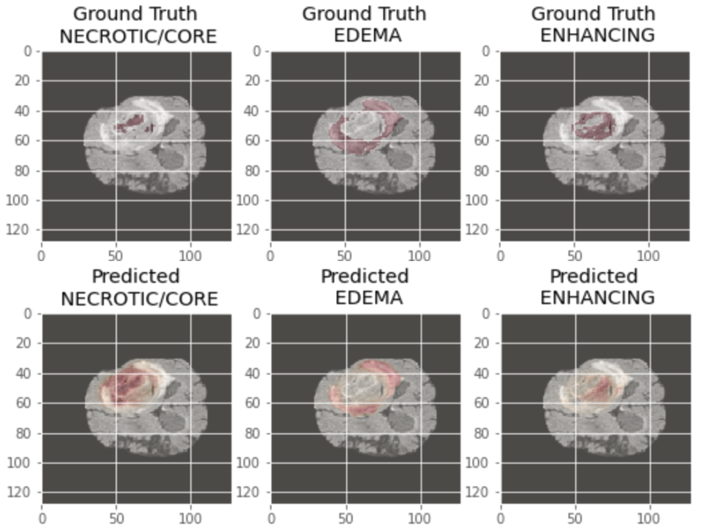
U-Net model: Evaluation
Notes:
- To assess model performance, we used the held-out test set and visualized model predictions and ground truths in tandem for each class and observed that they largely overlapped.
- Note the alignment and misalignment between ground truth labeling and predictions.

Slide 10
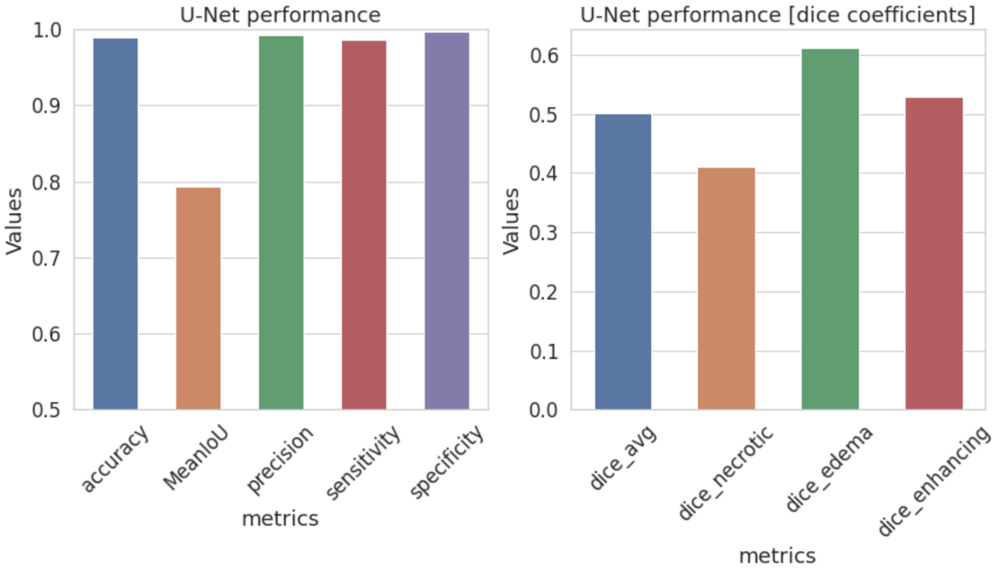
U-Net performance
Accuracy, Precision, Sensitivity, Specificity.
These four metrics are more susceptible to the class imbalance issue.
Intersection-over-Union (IoU), Dice coefficient (F1 score).
Dice NECROTIC/CORE, Dice EDEMA, Dice ENHANCING.
Notes:
We then quantified model performance using diverse metrics.
Accuracy: The percent of pixels that are correctly classified.
Precision: The ratio of true positives to all predicted positives (true positives + false positives).
Sensitivity: The ratio of true positives to all possible positives (true positives + false negatives).
Specificity: The ratio of true negatives to all possible negatives (true negatives + false positives).
Intersection-over-Union (IoU): The ratio between the area of overlap and the area of union.
Dice coefficient (F1 score): 2 * The Area of Overlap divided by the sum of the total number of pixels.

Slide 11
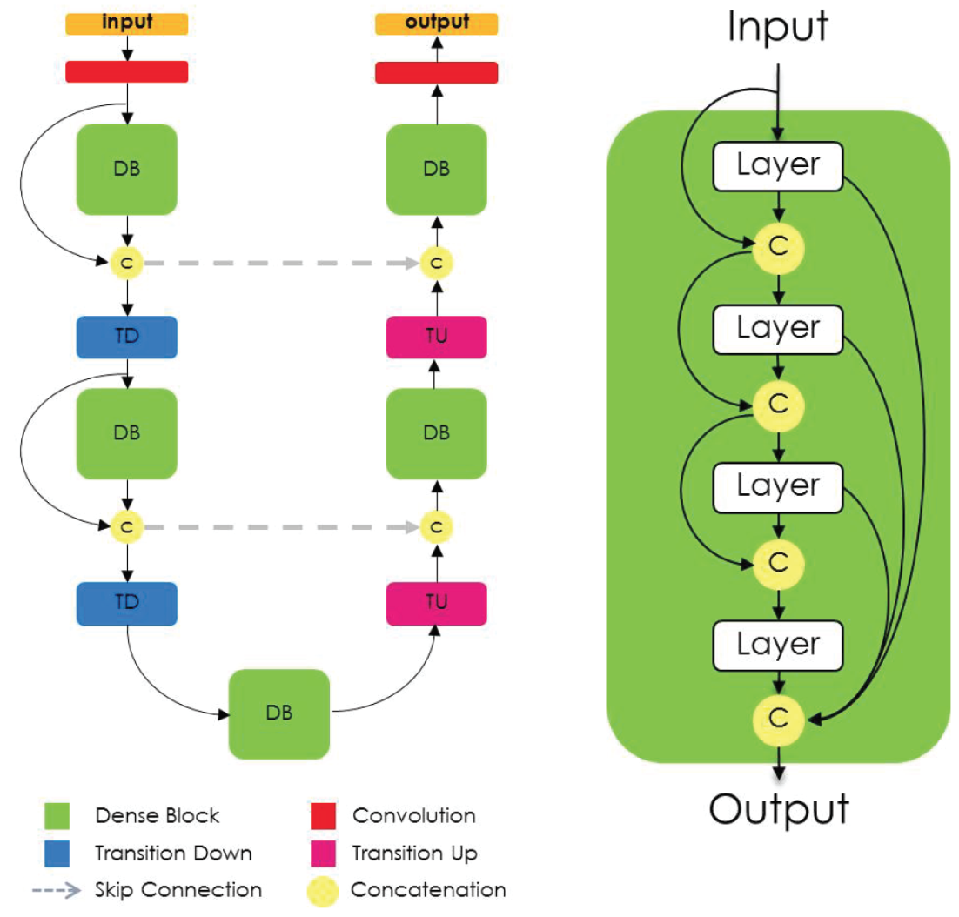
FC-DenseNets model: Architecture
Image credit: https://arxiv.org/abs/1611.09326
Notes:
The architecture of the full-connected DenseNets (FC-DenseNets) is similar to that of the U-Net in the sense that it comprises downsampling (contracting) and upsampling (expanding) paths as well as the skip connections from the downsampling to the upsampling path.
The downsampling path incorporated three dense blocks, in which all feature outputs are iteratively concatenated in a feedforward fashion to facilitate the feature reuse.
Each dense block comprises several repetitions of a series that consists of batch normalization, activation, convolution and dropout.
The last layer of the downsampling path is referred to as a bottleneck which is a dense block.
The upsampling path comprises convolution, upsampling operations (transposed convolutions), and skip connections.
Transition up modules upsample the previous feature maps, which are then concatenated to the ones coming from the skip connection to form the input of a new dense block.
The last dense block summarizes the information contained in all the previous dense blocks at the same resolution.
Note that some information from earlier dense blocks is lost in the transition down due to the pooling operation.
Nevertheless, this information is available in the downsampling path of the network and can be passed via skip connections.
Hence, the dense blocks of the upsampling path are computed using all the available feature maps at a given resolution, leading to a very deep FC-DenseNets.

Slide 12
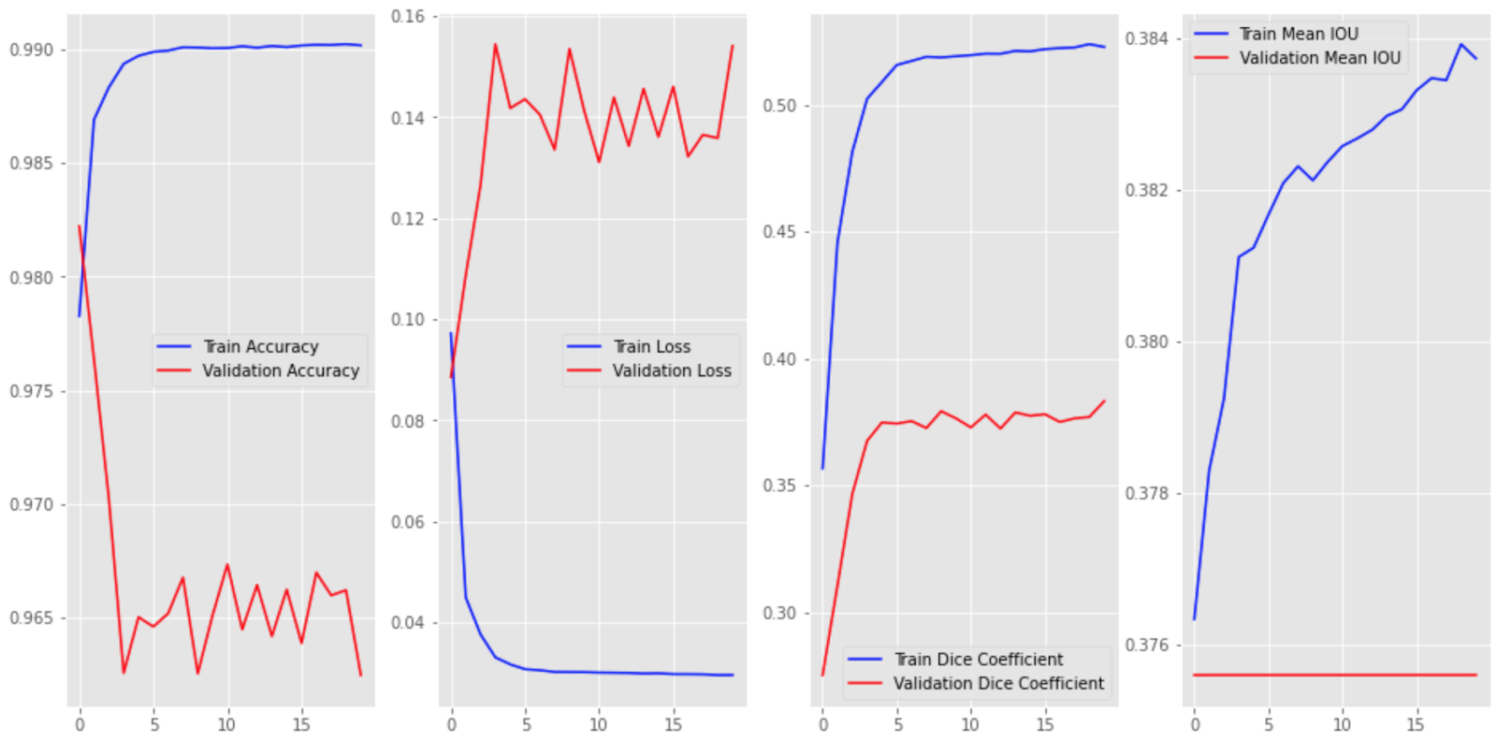
FC-DenseNets model: Training log
FC-DenseNets involve much greater depths and feature maps and led to a memory issue.
To circumvent the memory issue, images had to be resized to 64 x 64 pixels.
We observed convergence of train loss, but not validation loss.
Evaluation metrics improved on the train set, but not the validation set.

Slide 13
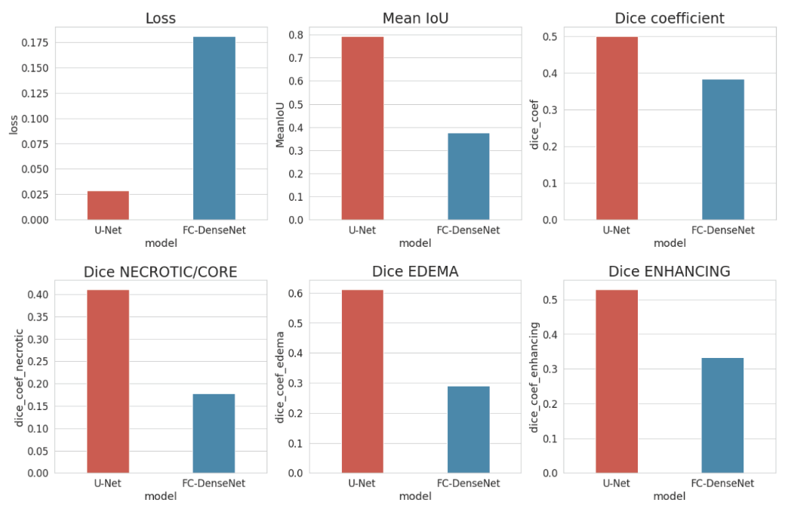
Comparing U-Net and FC-DenseNets performance

Slide 14
Conclusion
We trained two of the state-of-the-art convolutional neural networks for segmentation of brain tumor subregions on MRI scans.
The U-Net with relatively simple architecture outperformed FC-DenseNets with greater depths and model complexity.
Admittedly, performance of either model could be improved by adjusting:
Model parameters (e.g., depths, the # of feature maps etc.).
Hyper parameters (e.g., learning rate).
Other schemes:
Data augmentation.
Post processing (e.g., conditional random fields).
Notes:
We tackled a brain tumor detection task by end-to-end training two of the state-of-the-art convolutional neural networks for semantic image segmentations.
The U-Net model had a relatively simple architecture, and it could be relatively easily implemented and trained on a single NVIDIA GPU (TESLA P100) with 16GB memory.
The U-Net outperformed the more complex and deeper FC-DenseNets at least on the versions of the models we configured.
Admittedly, there are many model parametric, hyper-parametric, and schematic (e.g. postprocessing) spaces we have not exhaustively explored that might improve model performance, which would be an important direction of future studies.

